Slide 1
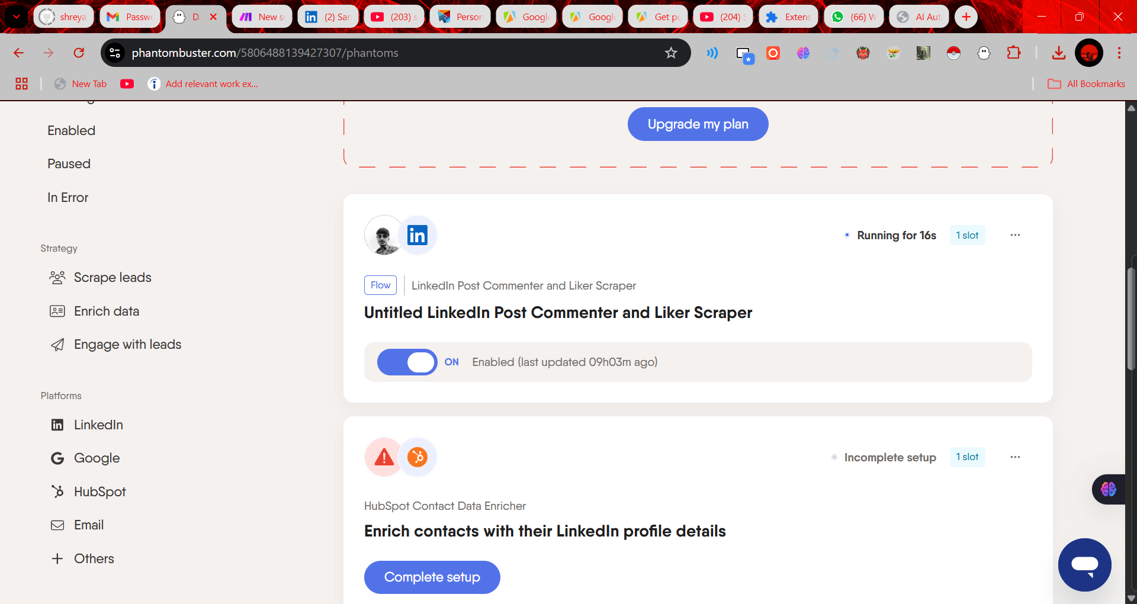
The LinkedIn Post Commenter and Liker Scraper in Phantombuster collects the LinkedIn profiles of people who liked or commented on a specific LinkedIn post.
This helps you:
Find potential leads
Get active LinkedIn users
Use that data for outreach, enrichment, or storing in Google Sheets

Slide 2
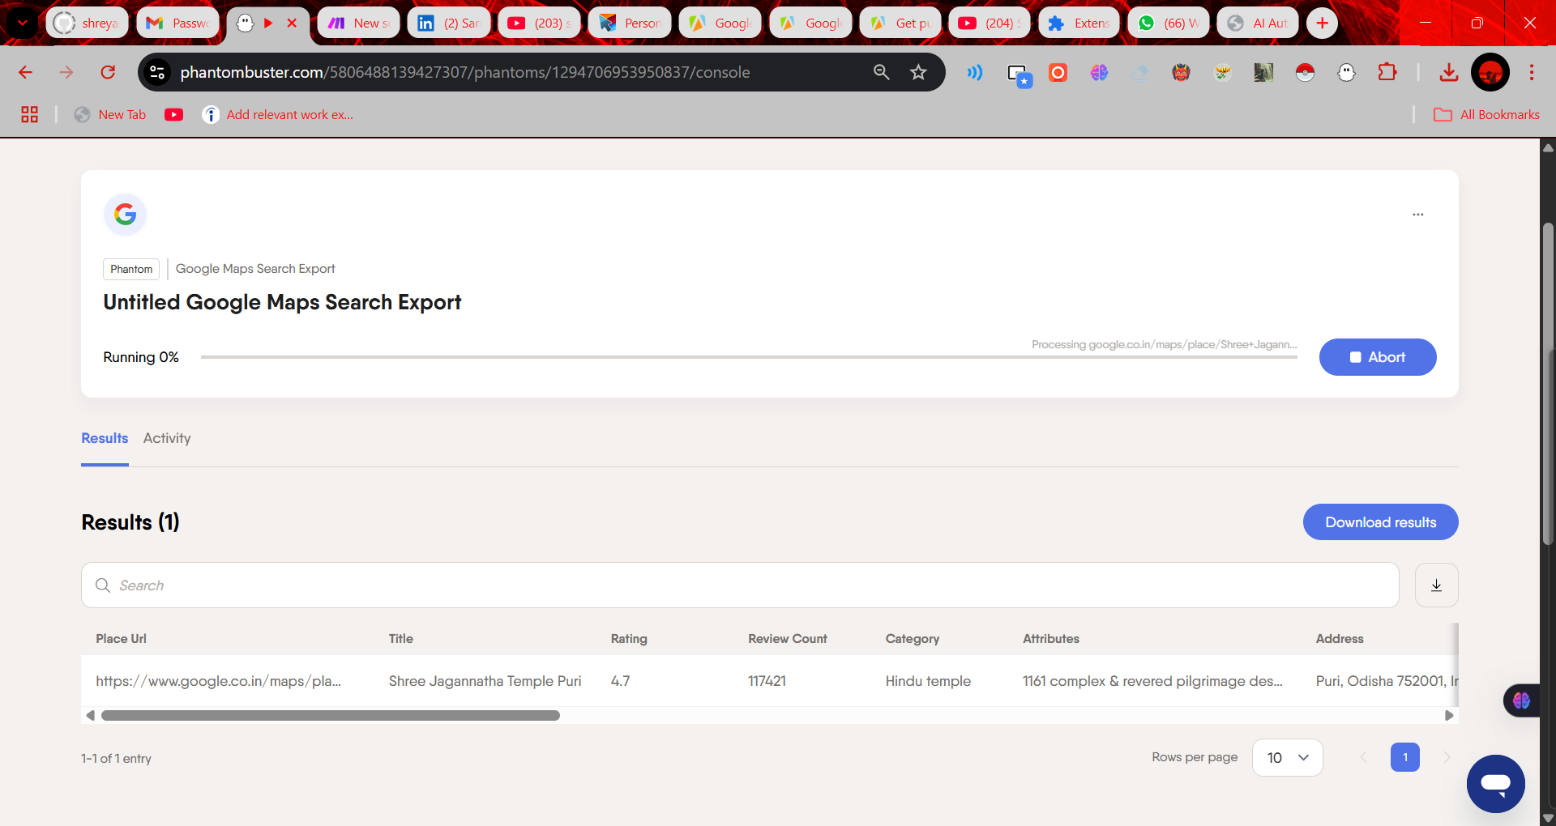
It scrapes business data from Google Maps, like:
Place name
Rating & review count
Category (e.g. restaurant, temple, clinic)
Address
Attributes (like "family-friendly", "wheelchair accessible")
Use case:
You can use it to gather local business leads for:
Outreach
Marketing
Enrichment (like emails, phone numbers)
Feeding into Google Sheets/CRM

